Slide 1
Asp.net MVC

Slide 2
Agenda
Asp.net MVC overview
URL Routing
Controller and Actions
Views
Ajax Helper Methods
Model Binding

Slide 3
Model-View-Controller
Controller - responsible for handling all user input
View - the visual representation of the model
Model - represents the logic of the application

Slide 4
MVC conventions
Controller classes must have names that end with Controller, such as ProductController, AdminController, and HomeController
Views and partial views go into the folder /Views/Controllername. For example, a view associated with the ProductController class would go in the /Views/Product folder.
Views/Shared/_Layout.cshtml, _ViewStart.cshtml

Slide 5
URL Routing
URL Pattern
http://mysite.com/Admin/Index
{controller}/{action}
Creating and Registering a Simple Route
Defining Default Values
routes.MapRoute("MyRoute", "{controller}/{action}",
new { controller = "Home", action = "Index" });

Slide 6
URL Routing
Using satic URL Segments
http://mydomain.com/Public/Home/Index
routes.MapRoute("", "Public/{controller}/{action}",
new { controller = "Home", action = "Index" });
http://mydomain.com/MyHome/Index
routes.MapRoute("", “My{controller}/{action}");
http://mydomain.com/Shop/Index
routes.MapRoute("ShopSchema", "Shop/{action}", new { controller = "Home" });

Slide 7
URL Routing
Constrianing Routes
Constrianing a Route Using a Regrular Expression
routes.MapRoute("MyRoute", "{controller}/{action}/{id}/{*catchall}",
new { controller = "Home", action = "Index", id = UrlParameter.Optional },
new { controller = "^H.*"});
Constraining a Route to a Set of Specific Values
routes.MapRoute("MyRoute", "{controller}/{action}/{id}/{*catchall}",
new { controller = "Home", action = "Index", id = UrlParameter.Optional },
new { controller = "^H.*", action = "^Index$|^About$"});
Constraining a Route Using HTTP Methods
routes.MapRoute("MyRoute", "{controller}/{action}/{id}/{*catchall}",
new { controller = "Home", action = "Index", id = UrlParameter.Optional },
new { controller = "^H.*", action = "Index|About", httpMethod = new HttpMethodConstraint("GET") });
Defining a Custom Constraint by implementing IRouteConstraint

Slide 8
URL Routing
Generating Outgoing URL in Views
Using the Routing System to Generate an Outgoing URL
@Html.ActionLink("Create New", "Create") based on based on the current routing configuration
<a href="/Product/Create">Create New</a>
Targeting Other Controllers
@Html.ActionLink("Target other controller - return to Home/Contact", "Contact", "Home")
Passing Extra Values
@Html.ActionLink("Edit", "Edit", new { id=item.ProductID })
<a href="/Product/Edit/1">Edit</a>

Slide 9
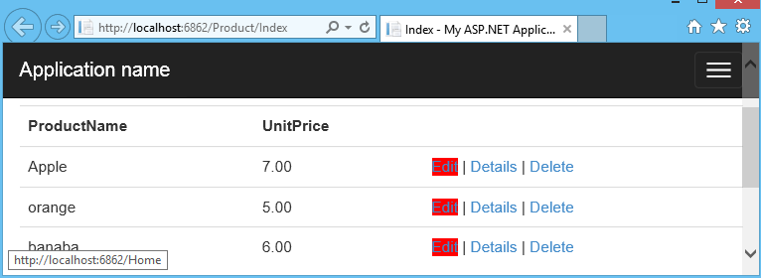
URL Routing
Specifying HTML Attributes
@Html.ActionLink("Edit", "Edit", new { id = item.ProductID }, new { id="anchorID"+ item.ProductID, style = "background-color:red;" })

Slide 10
URL Routing
Generating URLs (not links)
@Url.Action("Edit", "Product", new { id = 0 })
/Product/Edit/0

Slide 11
Controllers and Actions
Responsible for processing incoming requests, performing operations on the domain model, and selecting views to render to the user
System.Web.Mvc.Controller is the class provides three key features:
Action methods, Action results, Filters

Slide 12
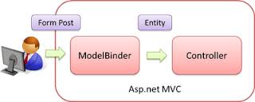
Controllers and Actions
Receiving Input
Getting Data from Context Objects (extract manually)
ViewBag.RequestUrl = Request.Url;
ViewBag.UserHostAddress = Request.UserHostAddress;
string serverName = Server.MachineName;
string userName = User.Identity.Name;
Using Action Method Parameters (value providers & model binders)

Slide 13
Controllers and Actions
Producing Output
Return an object derived from the ActionResult, MVC Framework calls the ExecuteResult method defined by ActionResult
ActionResult Types:

Slide 14
Controllers and Actions
Type | Description | Helper Methods
ViewResult | Renders the specified or default view template | View
PartialViewResult | Renders the specified or default partial view template | PartialView
RedirectToRouteResult | Issues an HTTP 301 or 302 redirection to an action method or specific route entry, generating a URL according to your routing configuration | RedirectToAction RedirectToActionPermanent RedirectToRoute RedirectToRoutePermanent
HttpUnauthorizedResult | Sets the response HTTP status code to 401 (meaning “not authorized”), ask the visitor to log in | None
HttpNotFoundResult | Returns a HTTP 404—Not found error | HttpNotFound
RedirectResult | Issues an HTTP 301 or 302 redirection to a specific URL | Redirect RedirectPermanent
JsonResult | Serialize data to json format | Json
EmptyResult | Does nothing | None

Slide 15
Controllers and Actions
Passing Data from an Action Method to a View
Providing a View Model Object
public ViewResult Index() {
DateTime date = DateTime.Now;
return View(date);
}
public ActionResult Index()
{
var products = db.Products.Include(p => p.Categories).Include(p => p.Suppliers);
return View(products.ToList());
}
Passing Data with the View Bag

Slide 16
Controllers and Actions
Performing Redirections
public RedirectResult RedirectToAbout()
{
return Redirect("/Home/About");
//return RedirectPermanent("/Home/About");
}
http://localhost:7973/Home/About
public RedirectToRouteResult RedirectToRouteResult()
{
return RedirectToRoute(new { controller = "Example", action = "Index", ID = "MyID" });
}
http://localhost:7973/Example/Index/MyID

Slide 17
Views
Razor Engine
Razor is the view engine that was introduced with MVC 3 and replaced the previous view engine (known as the ASPX or Web Forms engine).
Using Sections
Provides regions of contents within a layout
@section Footer {
<div class="view">
This is the footer
</div>
}
Using Partial Views
@Html.Partial("MyPartial")
Using Child Actions
[ChildActionOnly]
public ActionResult Time()
{
return PartialView(DateTime.Now);
}
@Html.Action("Time")

Slide 18
Views
Html.TextBoxFor(x => x.FirstName)
<input id="FirstName" name="FirstName" type="text" value="" />
Built-in Helper Methods
BeginForm()
Html.CheckBox("myCheckbox", false)
<input id="myCheckbox" name="myCheckbox" type="checkbox" value="true" />
<input name="myCheckbox" type="hidden" value="false" />
Html.Hidden("myHidden", "val")
Html.RadioButton("myRadiobutton", "val", true)
Html.Password("myPassword", "val")
Html.TextArea("myTextarea", "val", 5, 20, null)
Html.TextBox("myTextbox", "val")
<input id="myTextbox" name="myTextbox" type="text" value="val" />
Html.Label("ProductName","Product Name")
<label for="ProductName">Product Name</label>

Slide 19
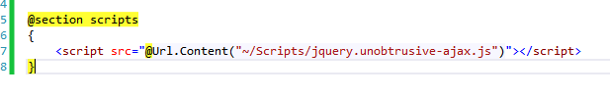
Ajax Helper Methods
Add javascript library
jquery.unobtrusive-ajax.js
bundles.Add(new ScriptBundle("~/bundles/jquery").Include(
"~/Scripts/jquery-{version}.js", "~/Scripts/jquery.unobtrusive*"));
2. use @RenderSection("scripts", required: false)

Slide 20
Ajax Helper Methods
Use Ajax Link

